Slide 1
Actor-Critic:PPO

Slide 2
Contents
Advantage function
Generalized Advantage Estimator (GAE)
Off-policy Policy Gradient
Off-policy Actor-Critic
Proximal Policy Optimization(PPO)
Code Ex.
PPO continuous action
Code Ex.

Slide 3
Advantage GAE

Slide 4
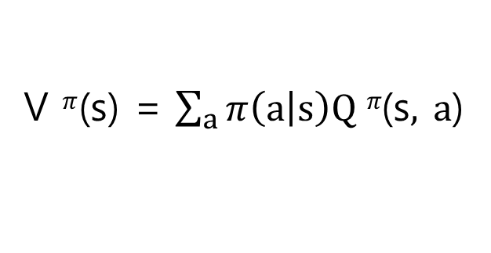
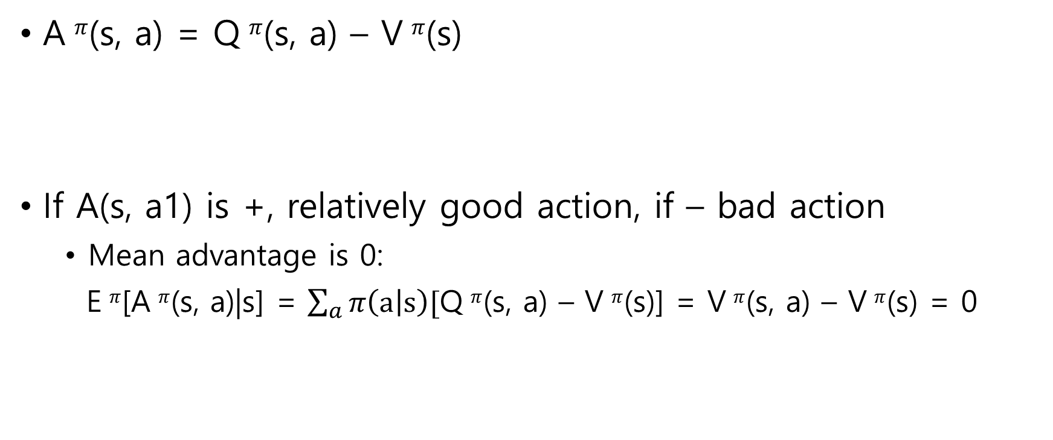
Advantage function
A $π$(s, a) = Q $π$(s, a) – V $π$(s)
If A(s, a1) is +, relatively good action, if – bad action
Mean advantage is 0:
E $π$[A $π$(s, a)|s] = $\sum_{a}{π\left(a | s\right)[}$Q $π$(s, a) – V $π$(s)] = V $π$(s, a) – V $π$(s) = 0
V $π$(s) = $\sum_{a}{π\left(a | s\right)Q π\text{(}\text{s}, a\text{)}}$

Slide 5
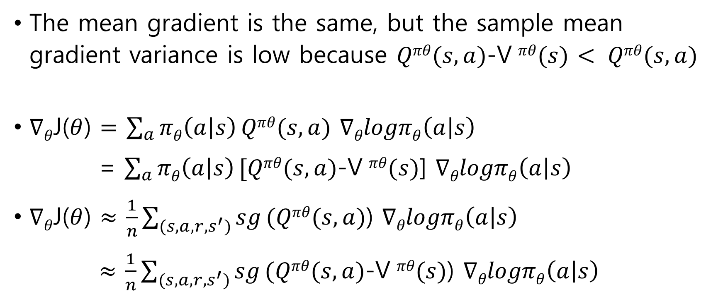
Advantage function
The mean gradient is the same, but the sample mean gradient variance is low because $Qπθ(s,a)$-V $πθ(s)$ $< Qπθ(s,a)$
$∇θ$J($θ$) $=$ $\sum_{a}{πθ\left(a | s\right)}Qπθ(s,a)$ $∇θlogπθ\left(a | s\right)$
= $\sum_{a}{πθ\left(a | s\right)}[Qπθ(s,a)$-V $πθ(s)$] $∇θlogπθ\left(a | s\right)$
$∇θ$J($θ$) $≈$ $\frac{1}{n}\sum_{(s,a,r,s^{′})}{sg}(Qπθ(s,a)$) $∇θlogπθ\left(a | s\right)$
$≈$ $\frac{1}{n}\sum_{(s,a,r,s^{′})}{sg}(Qπθ(s,a)\text{-}\text{V} πθ(s)$) $∇θlogπθ\left(a | s\right)$
High variance
Low variance

Slide 6
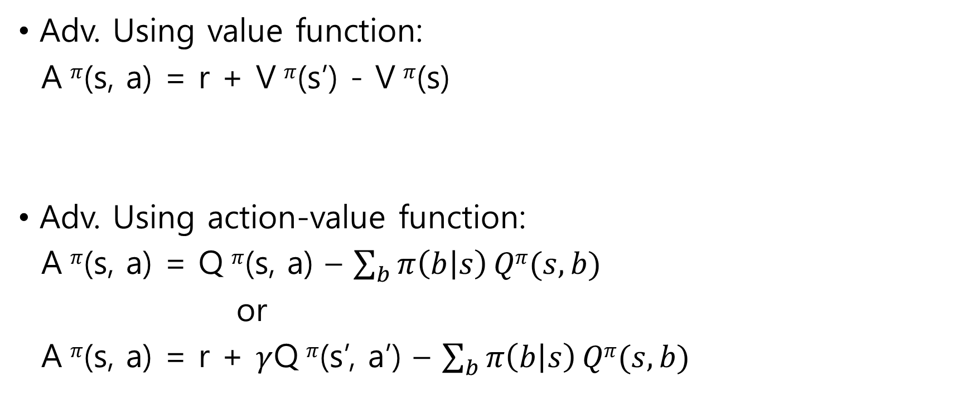
Advantage function
Adv. Using value function:
A $π$(s, a) = r + V $π$(s’) - V $π$(s)
Adv. Using action-value function:
A $π$(s, a) = Q $π$(s, a) – $\sum_{b}{π\left(b | s\right)}Qπ(s,b)$
or
A $π$(s, a) = r + $γ$Q $π$(s’, a’) – $\sum_{b}{π\left(b | s\right)}Qπ(s,b)$
1-step TD error!

Slide 7
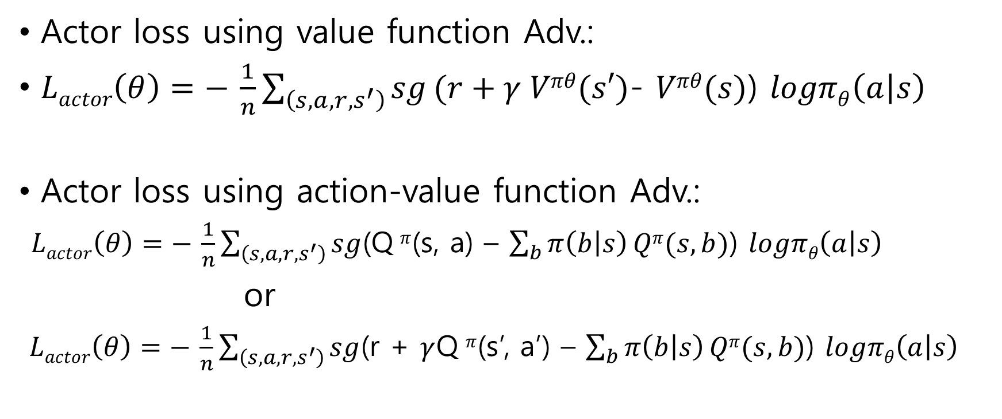
Advantage function
Actor loss using value function Adv.:
$Lactor\left(θ\right)=− \frac{1}{n}\sum_{\left(s,a,r,s^{′}\right)}{sg}(r+γ Vπθ(s′)$- $Vπθ(s)$) $logπθ\left(a | s\right)$
Actor loss using action-value function Adv.:
$Lactor\left(θ\right)=− \frac{1}{n}\sum_{\left(s,a,r,s^{′}\right)}{sg}$(Q $π$(s, a) – $\sum_{b}{π\left(b | s\right)}Qπ(s,b)$) $logπθ\left(a | s\right)$
or
$Lactor\left(θ\right)=− \frac{1}{n}\sum_{\left(s,a,r,s^{′}\right)}{sg}$(r + $γ$Q $π$(s’, a’) – $\sum_{b}{π\left(b | s\right)}Qπ(s,b)$) $logπθ\left(a | s\right)$
Could be n-step TD target!
Could be n-step TD target!

Slide 8
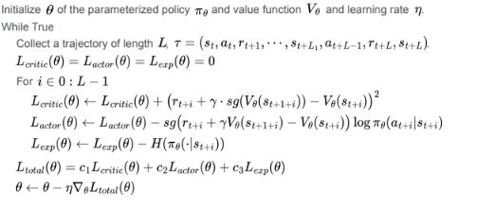
Advantage function

Slide 9
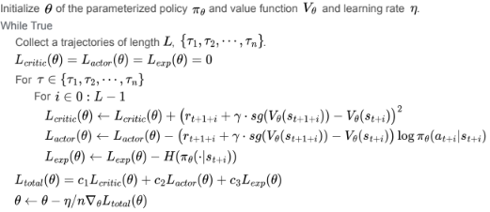
Advantage function

Slide 10
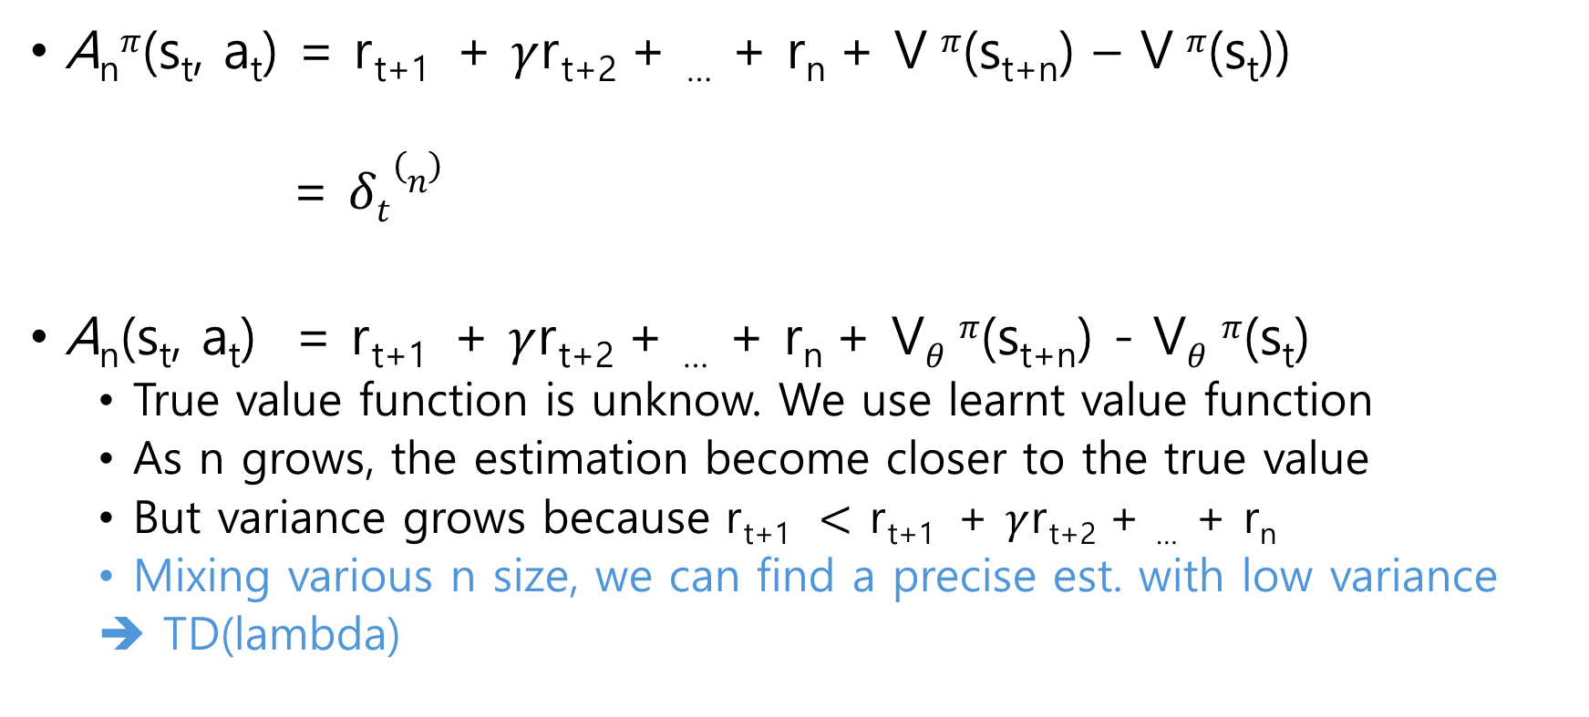
GAE
A_{n}$π$(s_{t}, a_{t}) = r_{t+1} + $γ$r_{t+2} + … + r_{n} + V $π$(s_{t+n}) – V $π$(s_{t}))
= $δt(n)$
A_{n}(s_{t}, a_{t}) = r_{t+1} + $γ$r_{t+2} + … + r_{n} + V$θ$ $π$(s_{t+n}) - V$θ$ $π$(s_{t})
True value function is unknow. We use learnt value function
As n grows, the estimation become closer to the true value
But variance grows because r_{t+1} $<$ r_{t+1} + $γ$r_{t+2} + … + r_{n}
Mixing various n size, we can find a precise est. with low variance
➔ TD(lambda)
N-step TD target
N-step TD error

Slide 11
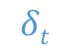
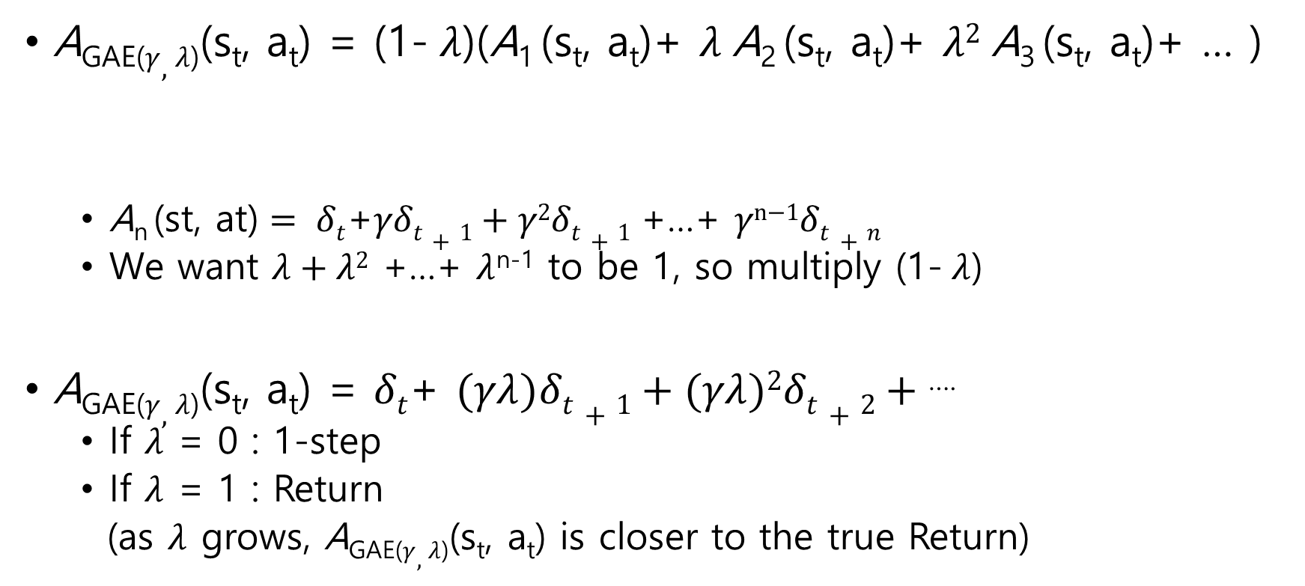
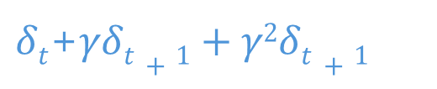
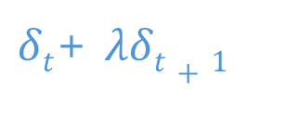
GAE
A_{GAE(}$γ,λ$₎(s_{t}, a_{t}) = (1- $λ$)(A₁ (s_{t}, a_{t})+ $λ$A₂ (s_{t}, a_{t})+ $λ2$A₃ (s_{t}, a_{t})+ … )
$\text{A}\text{n} \text{(}\text{st}\text{, }\text{at}\text{)}= δt$+$γδt+1+γ\text{2}δt+1$ +…+ $γ\text{n}\text{−1}δt+n$
We want $λ+λ2$ +…+ $λ$^{n-1} to be 1, so multiply (1- $λ$)
A_{GAE(}$γ,λ$₎(s_{t}, a_{t}) = $δt$+ $(γλ)δt+1+(γλ)\text{2}δt+2+$ ….
If $λ$ = 0 : 1-step
If $λ$ = 1 : Return
(as $λ$ grows, A_{GAE(}$γ,λ$₎(s_{t}, a_{t}) is closer to the true Return)
$$δt$$
$δt$+ $λδt+1$
$δt$+$γδt+1+γ\text{2}δt+1$
$$lower depencence on value function$$

Slide 12
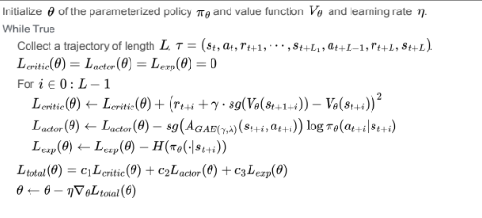
GAE

Slide 13
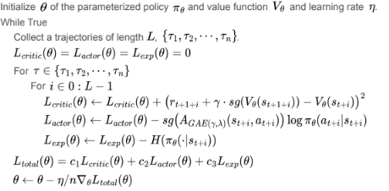
GAE

Slide 14
Off-policy PG Off-policy AC

Slide 15
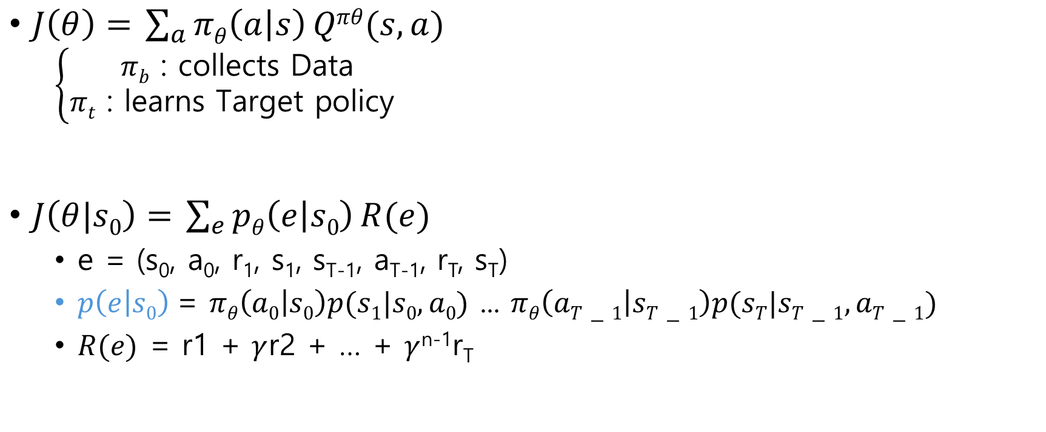
Off-policy Policy Gradient
$J\left(θ\right)=$ $\sum_{a}{πθ\left(a | s\right)}Qπθ(s,a)$
$$\left\{\begin{aligned}πb \text{: }\text{c}\text{ollects} \text{Data} \\ πt \text{: }\text{l}\text{earns} \text{Target} \text{policy} \end{aligned}\right.$$
$J\left(θ|s0\right)=$ $\sum_{e}{pθ\left(e | s0\right)}R(e)$
e = (s₀, a₀, r₁, s₁, s_{T-1}, a_{T-1}, r_{T}, s_{T})
$p\left(e | s0\right)$= $πθ\left(a0 | s0\right)p(s1|s0,a0)$ ... $πθ\left(aT−1 | sT−1\right)p(sT|sT−1,aT−1)$
$R(e)$ = r1 + $γ$r2 + … + $γ$^{n-1}r_{T}

Slide 16
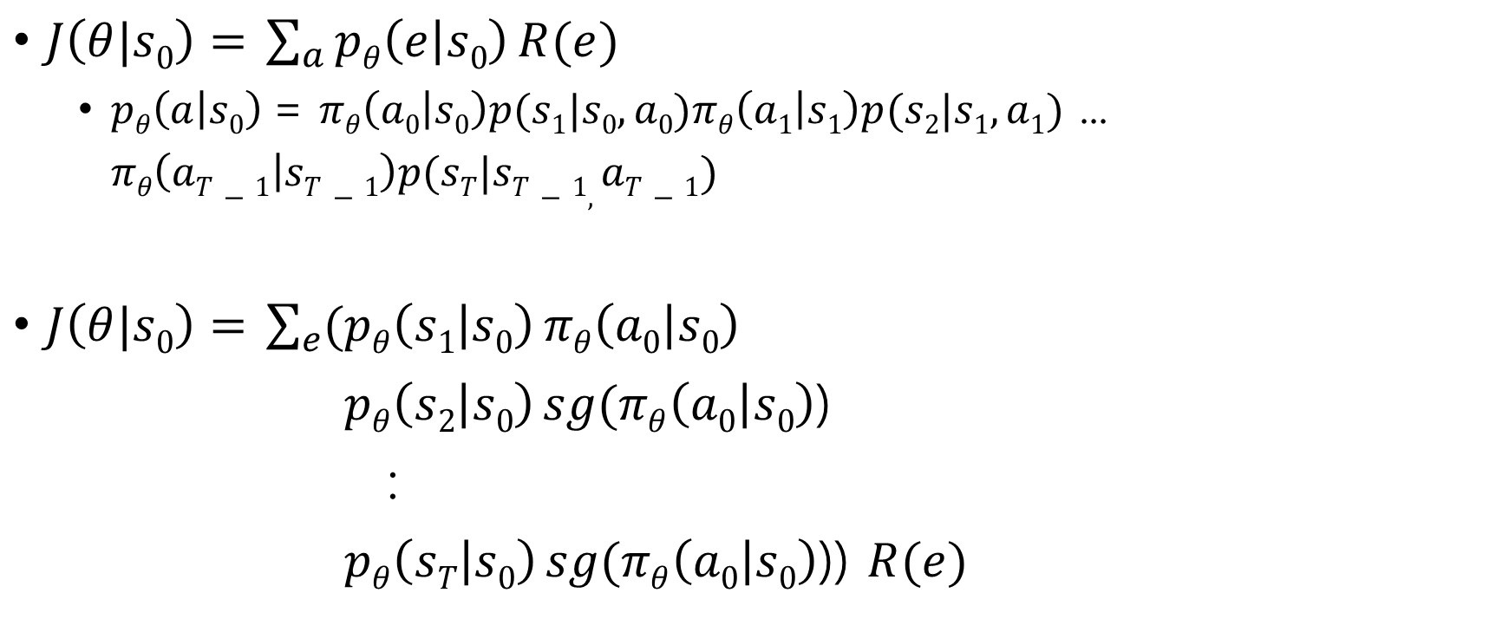
Off-policy Policy Gradient
$J\left(θ|s0\right)=$ $\sum_{a}{pθ\left(e | s0\right)}R(e)$
$pθ\left(a | s0\right)$= $πθ\left(a0 | s0\right)p(s1|s0,a0)πθ\left(a1 | s1\right)p(s2|s1,a1)$ ... $πθ\left(aT−1 | sT−1\right)p(sT|sT−1,aT−1)$
$J\left(θ|s0\right)=$ $\sum_{e}{(pθ\left(s1 | s0\right)}πθ\left(a0 | s0\right)$
$pθ\left(s2 | s0\right) sg(πθ\left(a0 | s0\right)$)
:
$pθ\left(sT | s0\right) sg(πθ\left(a0 | s0\right)$)) $R(e)$
stop gradient

Slide 17
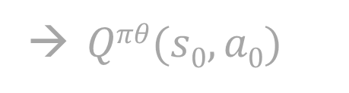
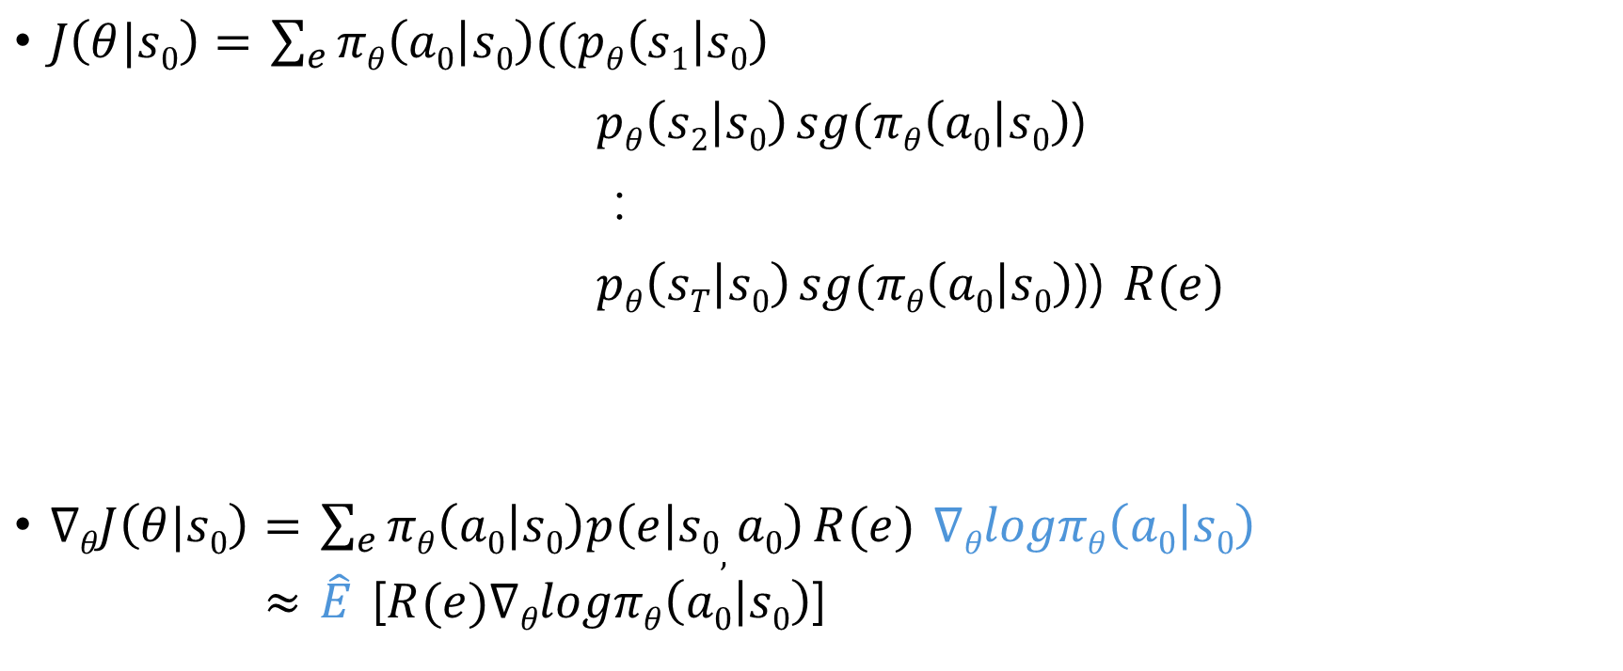

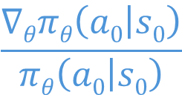
Off-policy Policy Gradient
$J\left(θ|s0\right)=$ $\sum_{e}{πθ\left(a0 | s0\right)((pθ\left(s1 | s0\right)}$
$pθ\left(s2 | s0\right) sg(πθ\left(a0 | s0\right)$)
:
$pθ\left(sT | s0\right) sg(πθ\left(a0 | s0\right)$)) $R(e)$
$∇θJ\left(θ|s0\right)=$ $\sum_{e}{πθ\left(a0 | s0\right)p\left(e | s0, a0\right)}R(e)$ $∇θlogπθ\left(a0 | s0\right)$
$≈$ $\hat{E}$ [$R(e)∇θlogπθ\left(a0 | s0\right)$]
→ $Qπθ(s0,a0)$
$$\frac{∇θπθ\left(a0 | s0\right)}{πθ\left(a0 | s0\right)}$$
→$∇θJ\left(θ|st\right)= \hat{E}$ [$R(et)∇θlogπθ\left(at | st\right)$]

Slide 18
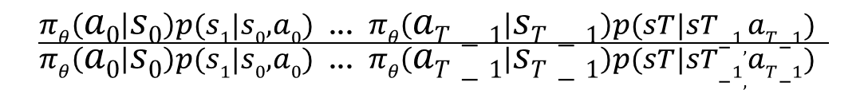
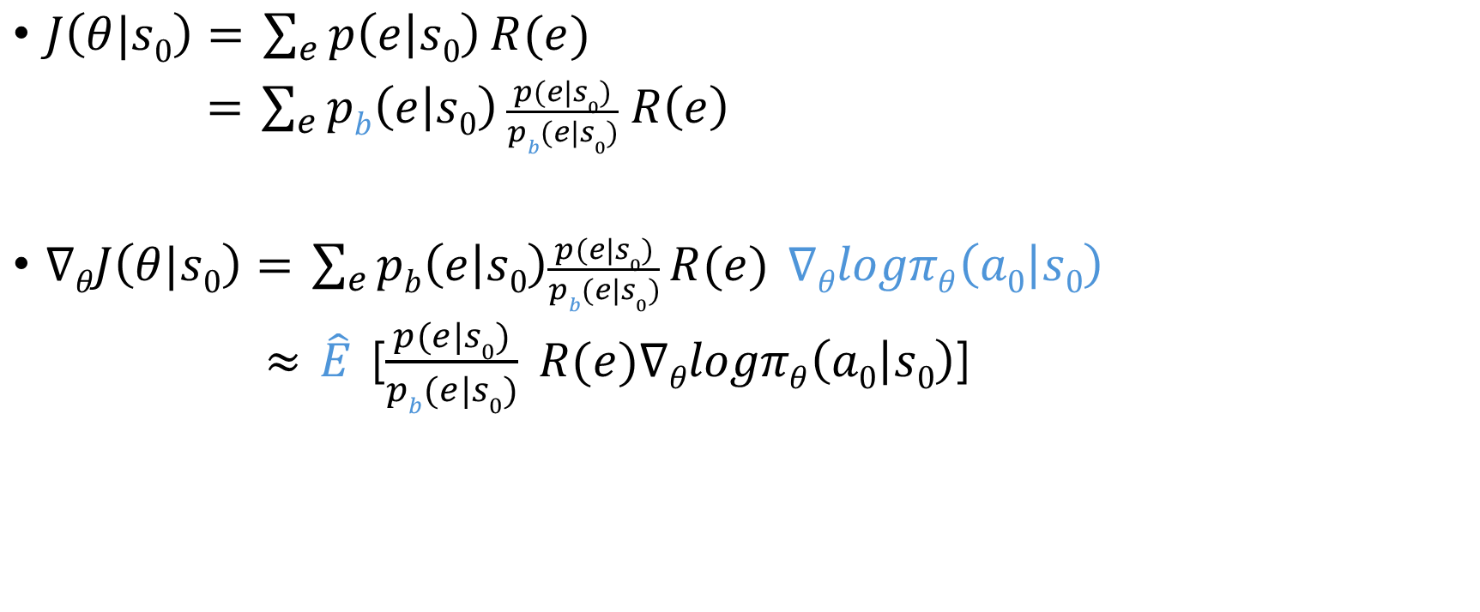
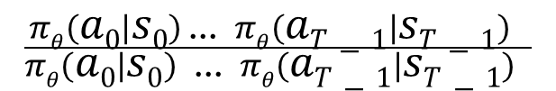
Off-policy Policy Gradient
$J\left(θ|s0\right)=$ $\sum_{e}{p\left(e | s0\right)}R(e)$
$=$ $\sum_{e}{pb\left(e | s0\right)}\frac{p(e|s0)}{pb(e|s0)} R\left(e\right)$
$∇θJ\left(θ|s0\right)=$ $\sum_{e}{pb\left(e | s0\right)\frac{p(e|s0)}{pb(e|s0)}}R(e)$ $∇θlogπθ\left(a0 | s0\right)$
$≈$ $\hat{E}$ [$\frac{p(e|s0)}{pb(e|s0)} R(e)∇θlogπθ\left(a0 | s0\right)$]
Importance sampling ratio
$$\frac{πθ\left(a0 | s0\right)p(s1|s0,a0)\text{ ...} πθ\left(aT−1 | sT−1\right)p(sT|sT−1,aT−1) }{πθ\left(a0 | s0\right)p(s1|s0,a0)\text{ ...} πθ\left(aT−1 | sT−1\right)p(sT|sT−1,aT−1) }$$
$$\frac{πθ\left(a0 | s0\right) \text{...} πθ\left(aT−1 | sT−1\right) }{πθ\left(a0 | s0\right)\text{ ...} πθ\left(aT−1 | sT−1\right) }$$
This value could be a very big, causing instability in learning due to the variance

Slide 19
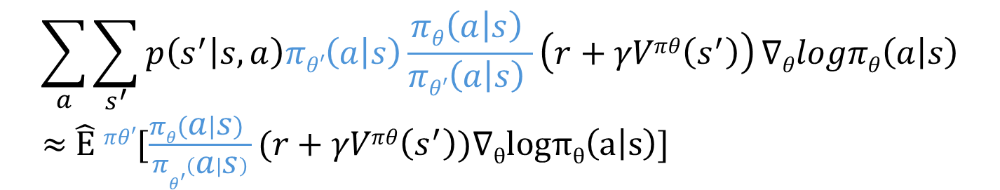
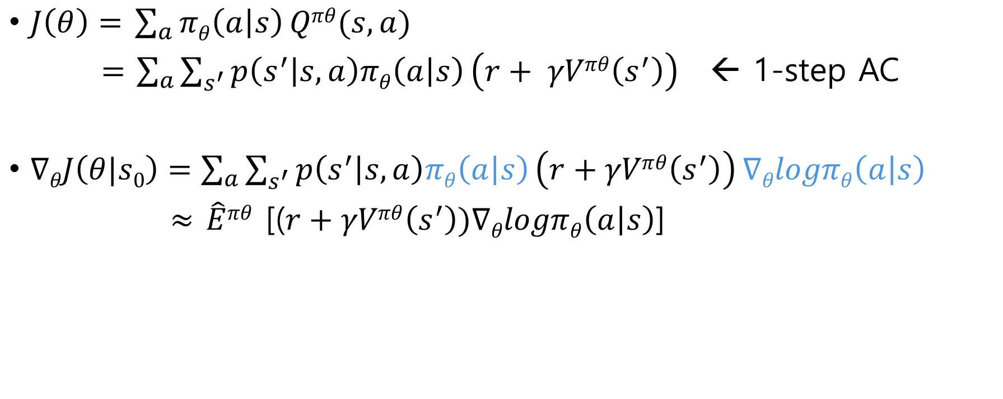
Off-policy Actor-Critic
$J\left(θ\right)=$ $\sum_{a}{πθ\left(a | s\right)}Qπθ(s,a)$
$=$ $\sum_{a}{\sum_{s^{′}}{p\left(s^{′} | s,a\right)πθ\left(a | s\right)}\left(r+ γVπθ\left(s^{′}\right)\right) }$ ← 1-step AC
$∇θJ\left(θ|s0\right)=\sum_{a}{\sum_{s^{′}}{p\left(s^{′} | s,a\right)πθ\left(a | s\right)}\left(r+γVπθ\left(s^{′}\right)\right)}∇θlogπθ\left(a | s\right)$
$≈$ $\hat{E}πθ$ [($r+γVπθ\left(s^{′}\right))∇θlogπθ\left(a | s\right)$]
$$\sum_{a}{\sum_{s^{′}}{p\left(s^{′} | s,a\right)πθ′\left(a | s\right)}\frac{πθ\left(a | s\right) }{πθ′\left(a | s\right) }\left(r+γVπθ\left(s^{′}\right)\right)}∇θlogπθ\left(a | s\right)$$
$≈$ $\hat{E}$ $πθ′$[$\frac{πθ\left(a | s\right) }{πθ^{′\left(a | s\right)}}(r+γVπθ\left(s^{′}\right))∇θlogπθ\left(a | s\right)$]

Slide 20
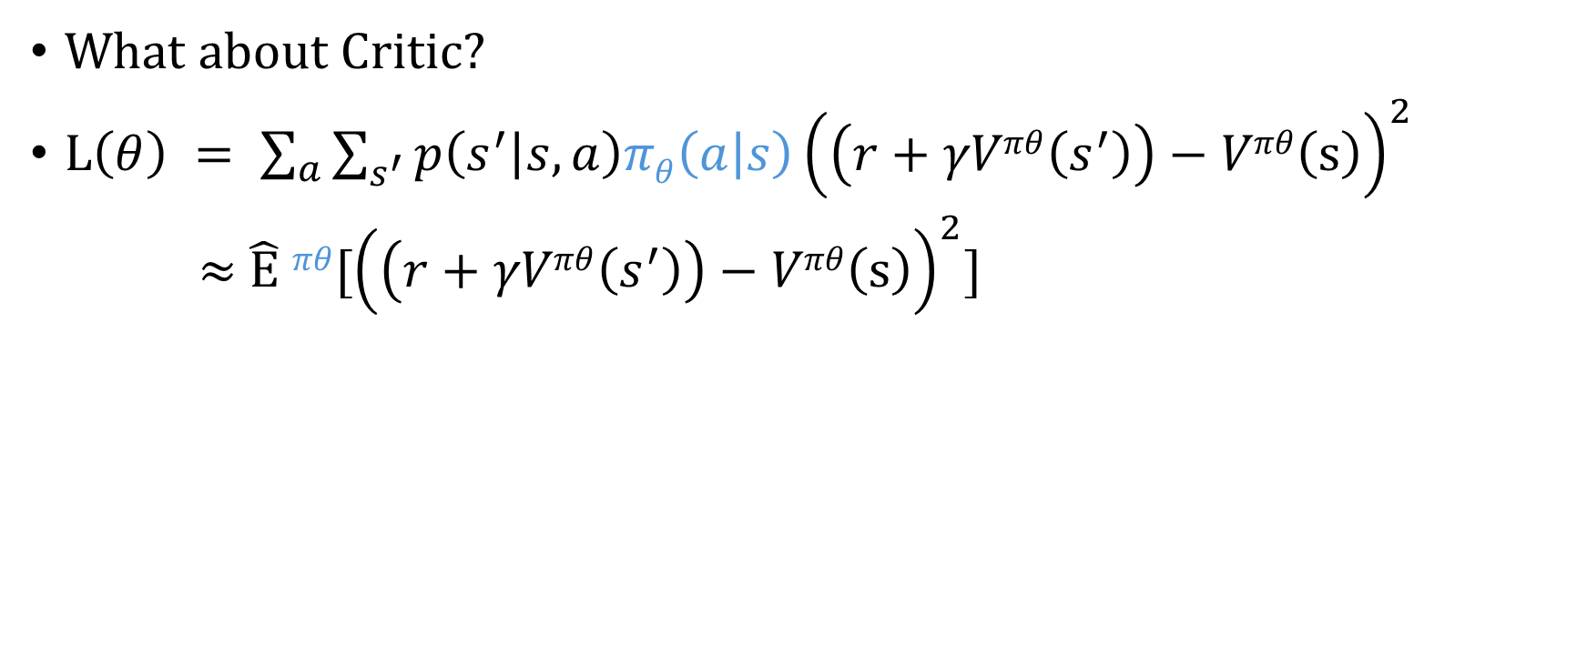
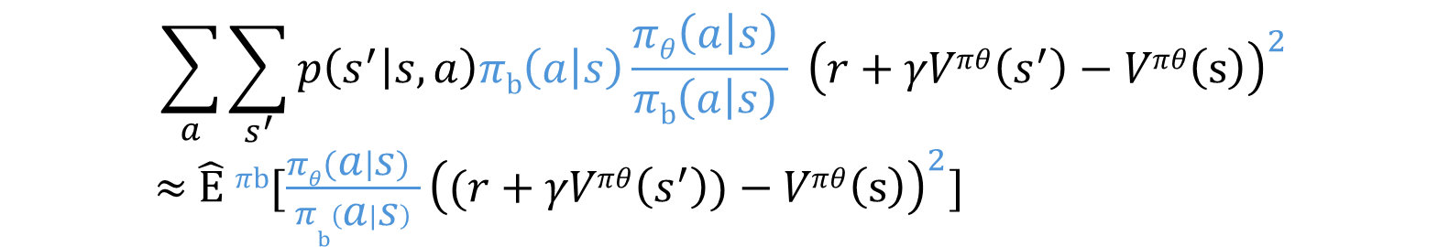
Off-policy Actor-Critic
What about Critic?
$L\left(θ\right) = \sum_{a}{\sum_{s^{′}}{p\left(s^{′} | s,a\right)πθ\left(a | s\right)}{\left(\left(r+γVπθ\left(s^{′}\right)\right)−Vπθ\left(s\right)\right)}^{2}}$
$≈$ $\hat{E}$ $πθ$[${\left(\left(r+γVπθ\left(s^{′}\right)\right)−Vπθ\left(s\right)\right)}^{2}$]
$$\sum_{a}{\sum_{s^{′}}{p\left(s^{′} | s,a\right)πb\left(a | s\right)}\frac{πθ\left(a | s\right) }{πb\left(a | s\right) } {\left(r+γVπθ\left(s^{′}\right)−Vπθ\left(s\right)\right)}^{2}}$$
$≈$ $\hat{E}$ $πb$[$\frac{πθ\left(a | s\right) }{πb^{\left(a | s\right)}}{\left((r+γVπθ\left(s^{′}\right))−Vπθ\left(s\right)\right)}^{2}$]
This value could also be a very big, causing instability in learning due to the variance

Slide 21
Proximal Policy Optimization(PPO)

Slide 22
Overview
PPO problem statement:
Q-learning is tricky,
vanilla PG is low in sample efficiency and unstable in learning
TRPO is complex, unable to share parameters btw. value and policy
PPO uses Off-policy data and update multiple times per sample (high sample efficiency)

Slide 23
Overview
PPO updates the policy conservatively
‘conservative’ means to stop the policy change too fast or dramatic
Updating multiple times per sample causes learning instabilities
(far different data distribution)
Actor learning w/o critic learnt well adds instability
(sub-optima convergence)

Slide 24
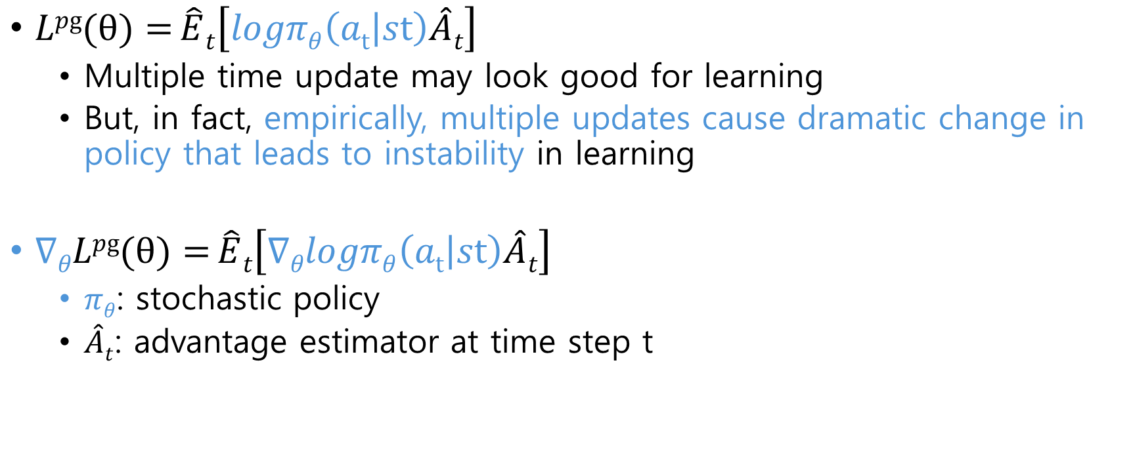
Method
$Lpg(θ)={\hat{E}t\left[logπθ\left(at | st\right)\hat{A}t\right]}$
Multiple time update may look good for learning
But, in fact, empirically, multiple updates cause dramatic change in policy that leads to instability in learning
$∇θLpg(θ)={\hat{E}t\left[∇θlogπθ\left(at | st\right)\hat{A}t\right]}$
$πθ$: stochastic policy
$\hat{A}t$: advantage estimator at time step t

Slide 25
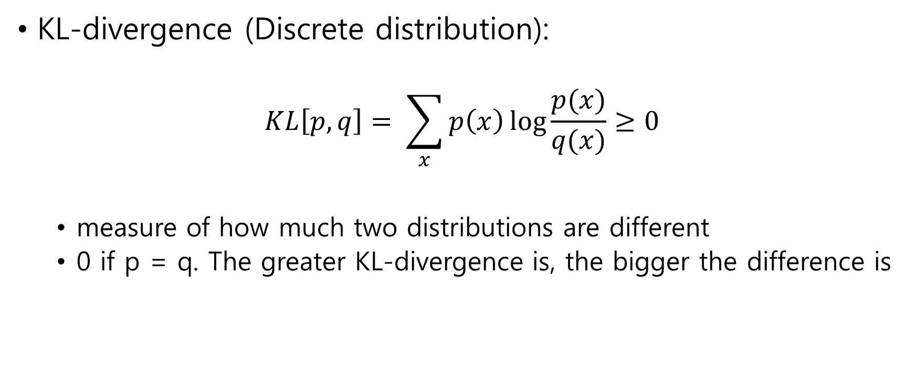
Method
KL-divergence (Discrete distribution):
$$KL\left[p, q\right]= \sum_{x}{p\left(x\right)\log{\frac{p(x)}{q(x)}≥0}}$$
measure of how much two distributions are different
0 if p = q. The greater KL-divergence is, the bigger the difference is
Want to increase value accuracy as much as possible while updating the policy very slowly(conservatively)

Slide 26
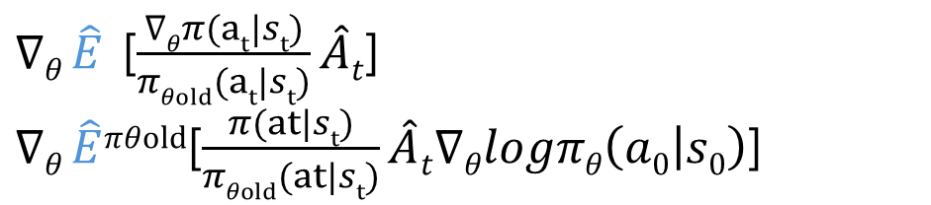
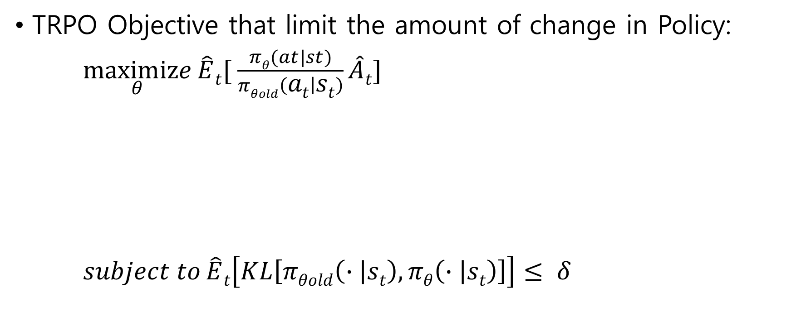
Method
TRPO Objective that limit the amount of change in Policy:
$\underset{θ}{maximize}{\hat{E}t[ \frac{πθ(at|st)}{πθold\left(at | st\right)}\hat{A}t]}$
$subject to{\hat{E}t\left[KL\left[πθold\left(∙ | st\right),πθ\left(∙ | st\right)\right]\right]≤ δ}$
$∇θ \hat{E}$ [$\frac{∇θπ(at|st)}{πθold(at|st)}\hat{A}t$]
$∇θ \hat{E}πθold$[$\frac{π(at|st)}{πθold(at|st)}\hat{A}t∇θlogπθ\left(a0 | s0\right)$]
Equal to off-policy PG

Slide 27
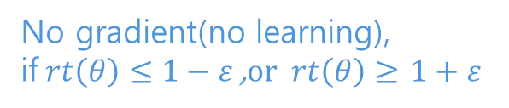
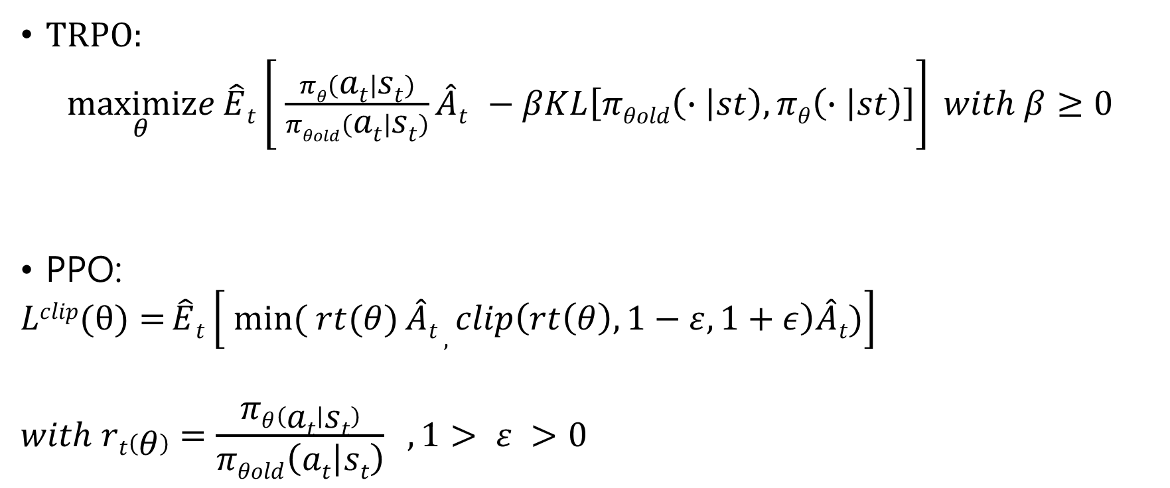


Objective
TRPO:
$\underset{θ}{maximize}{\hat{E}t\left[ \frac{πθ\left(at | st\right)}{πθold\left(at | st\right)}\hat{A}t −βKL\left[πθold\left(∙ | st\right),πθ\left(∙ | st\right)\right]\right]} with β≥0$
PPO:
$$Lclip(θ)={\hat{E}t\left[ \min_{}{( rt(θ)}\hat{A}t , clip\left(rt\left(θ\right), 1−ε, 1+ε\right)\hat{A}t)\right]}$$
$$with rt\left(θ\right)=\frac{πθ\left(at | st\right)}{πθold\left(at | st\right)} ,1> ε >0$$
Stop a new policy become too different from the behavior policy $πθold$
Setting $β$ is difficult
No gradient(no learning),
if$rt\left(θ\right)≤1−ε$ ,$or rt\left(θ\right)≥$ $1+ε$

Slide 28
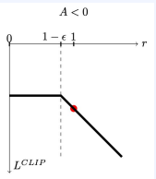
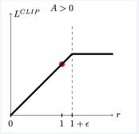
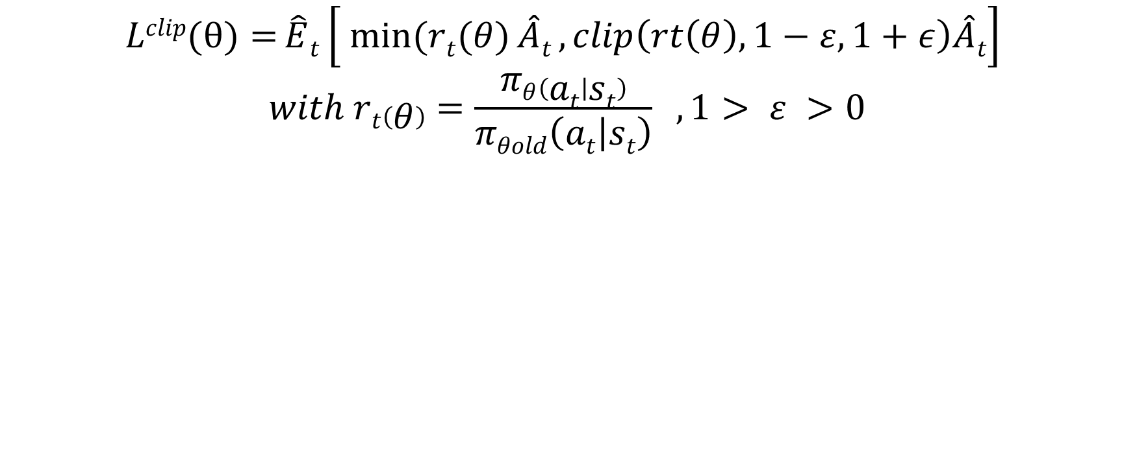
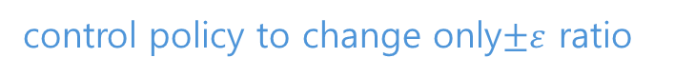
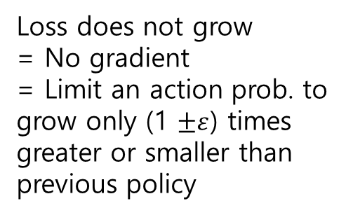
Objective
$$Lclip(θ)={\hat{E}t\left[ \min_{}{(rt(θ)}\hat{A}t , clip\left(rt\left(θ\right), 1−ε, 1+ε\right)\hat{A}t\right]}$$
$$with rt\left(θ\right)=\frac{πθ\left(at | st\right)}{πθold\left(at | st\right)} ,1> ε >0$$
Loss does not grow
= No gradient
= Limit an action prob. to grow only (1 $±ε$) times greater or smaller than previous policy
control policy to change only$±ε$ ratio

Slide 29
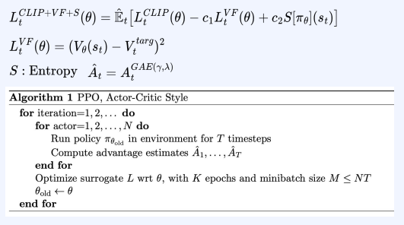
Objective
Maximize constraint off-policy gradient
Minimize loss
bonus
Parallel learning

Slide 30
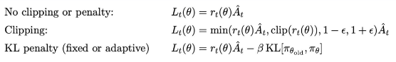
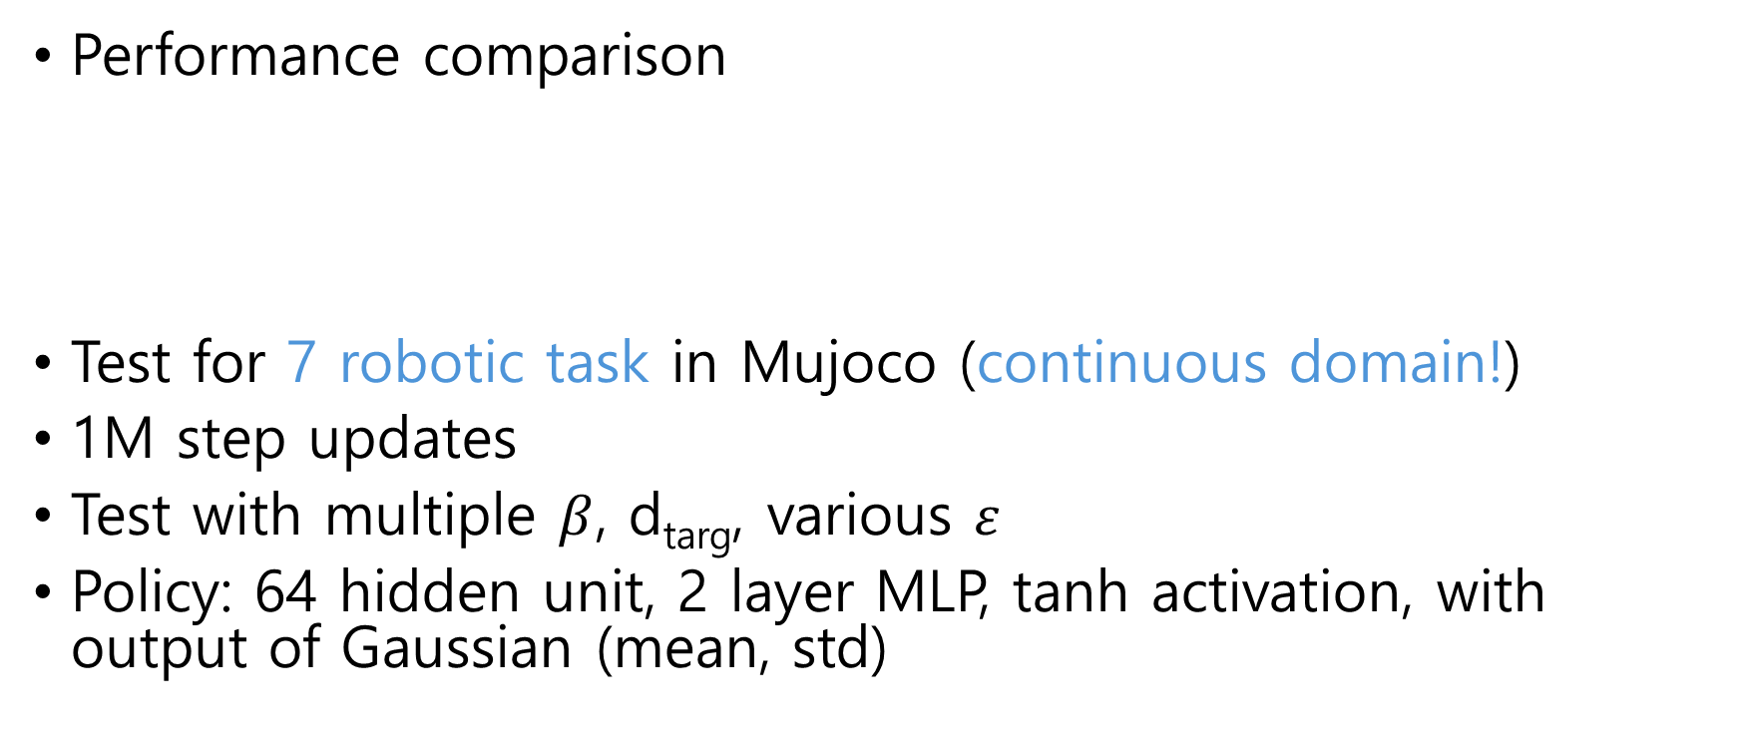
Results
Performance comparison
Test for 7 robotic task in Mujoco (continuous domain!)
1M step updates
Test with multiple $β$, d_{targ}, various $ε$
Policy: 64 hidden unit, 2 layer MLP, tanh activation, with output of Gaussian (mean, std)

Slide 31
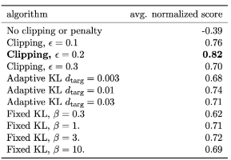
Results
No parameter sharing, no entropy bonus
3 random seed
avg. score for the last 100 before the end
Normalization 0~1
No clipping & KL penalty is -0.39
Clipping score is 0.82

Slide 32
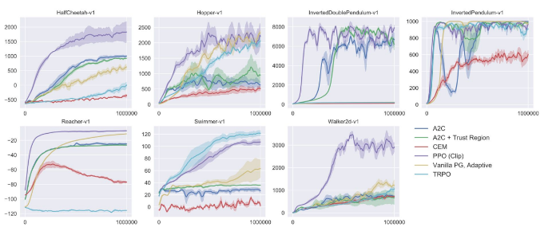
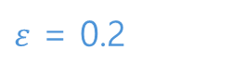
Results
PPO shows sample efficiency and stable learning
$ε$ = 0.2

Slide 33
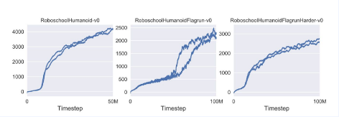
Results
High-dimensional continuous control test of PPO: 3D humanoid
RoboschoolHumannoid: moving forward
RoboschoolHumanoidFlagrun: moving forward with moving target every 200 timestep
RoboschoolHumanoidFlagranHarder: throw a cube to the robot tumble and stand-up again

Slide 34
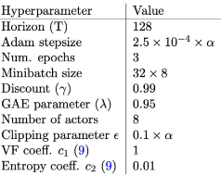
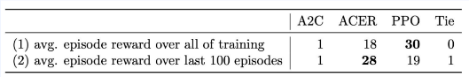
Results
Learning in Atari domain:
The number of games out of 48

Slide 35
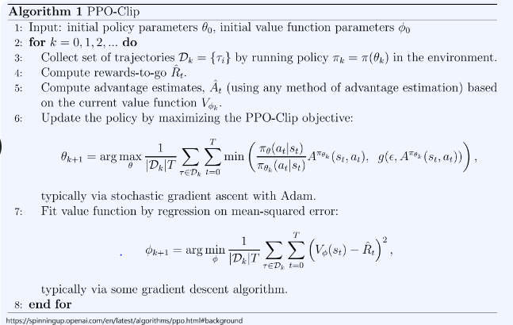
Code Ex.
configuration.py
utils.py
agent.py
train.py
eval.py

Slide 36
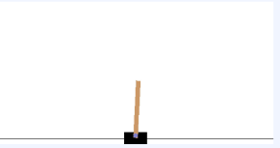
Code Ex.
Cartpole: move a cart (black) such that it balances a pendulum (brown) without moving too far from the center.
State: The agent observes current position and velocity of the cart, as well as angle and velocity of the pole (cart position, cart velocity, pole angle, pole angular velocity)
Action: It can act by pushing the cart to the left (value 0) or to the right (value 1).
Reward:+1 for every step

Slide 37
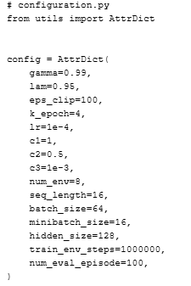
configuration.py
Critic loss constant
actor loss constant
Exploration loss constant (entropy loss constant)
Parallel environment to collect trajectories
Length of a trajectory
Learning from a batch that contains 64 trajectories

Slide 38
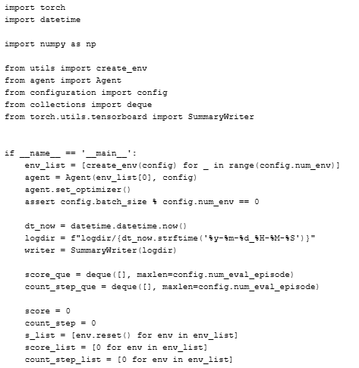
train.py
Vector environments
One agent

Slide 39

train.py
Parallelized environments shares config.train_env_steps load
One agent plays in multiple environments
Trajectory rollout until seq_length
pi is behavior policy
a is an action sampled
rom pi
Put the behavior policy into a trajectory in batch

Slide 40


$\hat{A}t$: advantage estimator at time step t is gae (
agent.py
※GAE(Generalized advantage function):
N-step TD target
$\hat{A}$_{n}(s_{t}, a_{t}) : r_{t+1} + $γ$r_{t+2} + $γ2$r_{t+3} + $γ3$r_{t+4} +… + r_{n} + V(s_{t+n}) – V(s_{t}))
g_{t}
N_batch
N_batch
N_batch
N_batch
r₀
r₁
R_{t-1}
$γ$₀
$γ$₁
$γ$_{n-t-1}
r_{t+1}
r_{t+2}
r_{n}
g₀
g₁
g_{n-1}
seq_length
Reward_seq_tensor
Gamma_power_seq_from_t
Reward_seq_from_t
Return_seq_tensor

Slide 41


agent.py
batch size is 64 trajectories
Each trajectory has seq. length 16

Slide 42

agent.py
A trajectory dictionary
We’ll record the behavior policy every time step the agent act.
Add a sample to the batch
When a seq. is full
Create a new seq.
Add the seq. to the batch

Slide 43

agent.py
Action sample using pi distribution

Slide 44

agent.py
Train repeating k epoch with minibatch_size
To insert into NN.
Mask for updating policy

Slide 45






agent.py
[P(a1),p(a2)], V(s_{t})
V(s_{t+1})
$\hat{A}t$ is GAE that uses N-step TD target
$V$alue target
$Critic loss(LVF$)
$$rt\left(θ\right)=\frac{πθ\left(at | st\right)}{πθold\left(at | st\right)}$$
$$Actor loss Lclip(θ)={\hat{E}t\left[ \min_{}{( rt(θ)}\hat{A}t , clip\left(rt\left(θ\right), 1−ε, 1+ε\right)\hat{A}t)\right]}$$

Slide 46





agent.py
$Entropy$ $bonus$
$Add all$loss
$$and make actor-critic loss$$
$$Gradient descent$$
$$Throw away$$
$$the batch$$

Slide 47
PPO Continuous Action

Slide 48

Continuous Action
PPO uses Gaussian policy
as stochastic policy

Slide 49

Init Buffer Class
Buffer to store collected episodes
An episode is,
state,
next_state,
action
reward
(value)
To Compute:
Policy distribution(old)
Advantage
Return

Slide 50


Collecting episodes
Initial sampling
$S0 \sim d(∙)$
Action sampling from Policy
$μt= πθ(s)$
$ε\sim N\left(o, I\right)$
$at= μ+ σεt$
Simulation
$st+1, rt+1, dt+1$= env.step($at$)
Next_state
Reward
Done, terminal information
Reparameterization trick

Slide 51

Loss function
Return Definition:
$Gt= \sum_{k=0}{γkRt+1+k}$
$Gt=Rt+1+γRt+1$
Return Calculation (Backward):
$Gt+1=0$
From t = T to t= 0, compute $Gt=Rt+1+γRt+1$
Generalized Advantage Estimation(GAE):
$δt=Rt+1+γV\left(st+1\right)−V(st)$
A_{t}$(λ)$ = $\sum_{k=0}{\left(γλ\right)k}δt+k$ = $δt$ +$γλ$ $\sum_{k=0}{\left(γλ\right)k}δt+1+k$ = $δt$ + $γλ$ A_{t+1}$(λ)$

Slide 52

Policy Loss
Differentiation performed
No differentiation:
(use no grad or detach() )

Slide 53


Value Loss
Differentiation performed

Slide 54

Code Ex.
Upload ‘proximal_policy_optimizatin.ipynb’ file onto Colab
The notebook includes ‘Mujoco’ environment, ‘Half Cheetah’
State(17):
(body parts) position,
(roter, axis) angle or velocity
Action(6):
Torque on 6 roters (-1~1)
Reward:
Forward_reward: moving-forward reward
ctrl_cost: penalty in taking too large action

